Slide 1
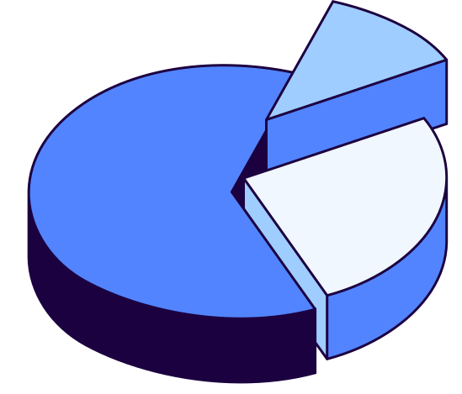
Football Player Departure Prediction Based on Weight Optimization Algorithms
Name: Ziming Chen
Supervisor: Shuo Wang

Slide 2
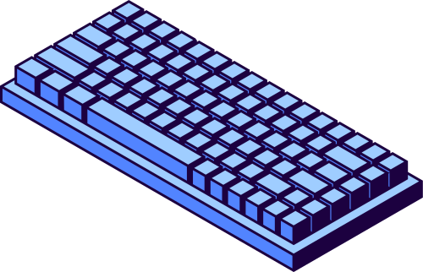
Introduction
- Construct multi-dimensional player departure prediction model
- Apply multiple optimization algorithms to find optimal weight configurations
- Provide scientific support for player contract renewal decisions
Background
- Player departure prediction is crucial for club strategic planning
- Traditional analysis methods lack quantitative metrics and prediction accuracy
- Develop real-time prediction system for club decision support

Slide 3

Project Construction Methodology
Data Collection → Preprocessing → Feature Engineering → Weight Optimization → Model Evaluation → Result Analysis
  Position-Specific Modeling: Specialized metrics for different player positions
  Percentile Scoring: Player performance evaluation based on league-wide standards
  Weight Optimization: Four algorithms to find optimal weight configurations
  Comprehensive Evaluation: Multiple ML metrics for thorough model assessment

Slide 4

Data Collection
Data Sources
  Primary Source: FBref website (https://fbref.com)
  Data Scope: Complete Serie A 2022-2023 season data
  Data Types: Basic stats, shooting, passing, defensive, goalkeeper-specific data
Data Acquisition
  Standard Stats: goals, assists, minutes played and other basic metrics
  Advanced Stats: xG, xA, progressive passes and other advanced metrics
  Position-Specific: Specialized metrics for forwards, midfielders, defenders, goalkeepers

Slide 5
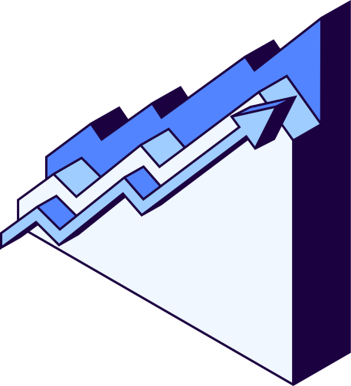
Player Metrics System
Forward | Midfielder | Defender | Goalkeeper
Attacking: Goals, Assists, Shots on Target, Expected Goals (xG) | Passing: Pass Completion Rate, Key Passes, Progressive Passes, Expected Assists (xAG) | Defensive: Tackles, Interceptions, Blocks, Clearances | Saves: Save Count, Save Percentage, Shots Faced
Creation: Shot Creating Actions, Goal Creating Actions, Shots per 90 | Possession: Touches, Successful Take-ons, Progressive Carries | Passing: Pass Completion Rate, Long Pass Accuracy, Passes to Final Third | Performance: Clean Sheets, Clean Sheet Rate, Goals Against per 90
Efficiency: Conversion Rate, Shot Accuracy | Organization: Passes to Final Third, Passes to Penalty Area | Stability: Playing Time, Age Factor | Special: Penalty Save Rate, Wins
Then, we used percentile calculation to compute relative performance based on players in the same position.
The formula for performance_score is: the percentile of each metric × its weight.

Slide 6
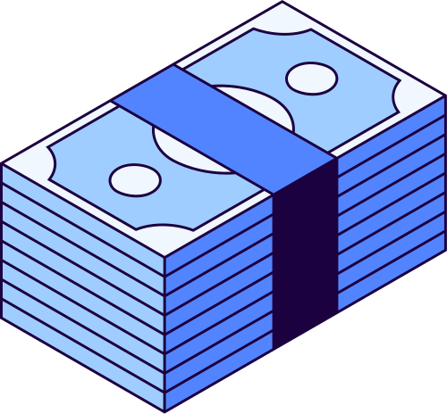
Optimization Algorithms
 | Genetic Algorithm (GA) | Particle Swarm Optimization (PSO) | Simulated Annealing (SA) | Random Search (RS)
Principle | Simulates biological evolution through selection, crossover, and mutation | Simulates bird flocking behavior with collaborative particle search | Simulates metal annealing process with gradual temperature reduction | Intelligent random strategy combining exploration and exploitation
Advantages | Strong global search capability, suitable for complex optimization | Fast convergence, simple parameter setting | Escapes local optima, suitable for non-convex optimization | Simple implementation, serves as comparison baseline
Parameters | Population size=10, Iterations=20 | Particles=30, Iterations=50 | Initial temperature=100, Max iterations=1000 | Iterations=1500, Smart strategy
Composite Score = 0.25*PR_AUC + 0.2*Balanced_Accuracy + 0.2*Kappa + 0.15*MCC + 0.1*Accuracy + 0.1*(1 - Brier_Score)

Slide 7
Machine Learning Evaluation Metrics
Precision-Recall AUC (PR-AUC)
- Definition: Measures model performance on imbalanced datasets
- Selection Reason: Departing players are minority class, PR-AUC more suitable than ROC-AUC
Cohen's Kappa Coefficient
- Definition: Classification performance metric considering random agreement
- Selection Reason: More reliable than accuracy, suitable for small sample evaluation
Brier Score
- Definition: Evaluates probability prediction accuracy
- Selection Reason: Focuses on probability calibration, not just classification results
- Processing: 1-Brier Score, higher is better
Balanced Accuracy
- Definition: Average of true positive rate and true negative rate
- Selection Reason: Avoids class imbalance impact on accuracy
Matthews Correlation Coefficient (MCC)
- Definition: Correlation coefficient considering all confusion matrix elements
- Selection Reason: Considered the most comprehensive single metric for binary classification
- Characteristics: Range [-1,1], 0 indicates random prediction

Slide 8
Optimal Weight Configuration
Each model is run ten times, and the average value is taken.
Algorithm | Accuracy | PR-AUC | Kappa | Brier | Balance_Accuracy | MCC
GA | 0.920±0.000 | 0.953±0.000 | 0.841±0.000 | 0.193±0.000 | 0.923±0.000 | 0.852±0.000
PSO | 0.920±0.000 | 0.960±0.009 | 0.841±0.000 | 0.189±0.000 | 0.923±0.000 | 0.852±0.000
SA | 0.684±0.099 | 0.830±0.064 | $40,000 | 0.218±0.010 | 0.690±0.095 | 0.407±0.189
RS | 0.920±0.000 | 0.954±0.008 | $100,000 | 0.192±0.001 | 0.923±0.000 | 0.852±0.000
Composite Score (based on average performance):
1. PSO: 0.894
2. RS: 0.892
3. GA: 0.892
4. SA: 0.629

Slide 9
Optimal Weight Configuration
Forward
  goals_weight: 0.150000
  assists_weight: 0.120000
  minutes_weight: 0.120000
  age_weight: 0.050000
  shots_on_target_weight: 0.080000
  conversion_rate_weight: 0.050000
  expected_goals_weight: 0.080000
  shot_creating_actions_weight: 0.080000
  goal_creating_actions_weight: 0.050000
  shots_per_90_weight: 0.050000
  base_risk: 0.257264
  risk_multiplier: 0.700000
Midfielder
  assists_weight: 0.150000
  minutes_weight: 0.120000
  age_weight: 0.083103
  pass_completion_weight: 0.050000
  progressive_passes_weight: 0.080000
  key_passes_weight: 0.150000
  expected_assists_weight: 0.080000
  touches_weight: 0.050000
  progressive_carries_weight: 0.050000
  successful_take_ons_weight: 0.050000
  base_risk: 0.200000
  risk_multiplier: 0.700000
Defender
  minutes_weight: 0.150000
  age_weight: 0.050000
  progressive_passes_weight: 0.120000
  pass_completion_weight: 0.080000
  long_pass_completion_weight: 0.050000
  passes_to_final_third_weight: 0.050000
  tackles_weight: 0.080000
  interceptions_weight: 0.080000
  blocks_weight: 0.050000
  clearances_weight: 0.050000
  base_risk: 0.200000
  risk_multiplier: 0.685508
Goalkeeper
  minutes_weight: 0.120000
  age_weight: 0.071191
  saves_weight: 0.150000
  save_percentage_weight: 0.098458
  clean_sheets_weight: 0.080000
  clean_sheet_percentage_weight: 0.067658
  goals_against_per_90_weight: 0.082167
  penalty_save_rate_weight: 0.059067
  shots_faced_weight: 0.120000
  wins_weight: 0.084329
  base_risk: 0.400000
  risk_multiplier: 0.700000
departure_prob = base_risk + (1 - performance_score) × risk_multiplier
Therefore, we choose PSO and build a model for transfer prediction in the new season.

Slide 10

Future Work
8.19-8.21: Revise the project based on the demonstration feedbacks and complete the entire coding part of the project by August 21
8.21-8.27: Complete the project report and submit it to the supervisor for feedback
8.27-9.1: Revise the report based on the supervisor’s feedback and submit it
Thank You

